Slide 1


AMERICAN INTERNATIONAL UNIVERSITY–BANGLADESH (AIUB)
FACULTY OF SCIENCE & TECHNOLOGY
DEPARTMENT OF CSE
FALL 2024-2025
Section: B, Group: 08
Supervised By
DR. MD. SAEF ULLAH MIAH
Group Members
Md. Mirazul Hasan Most. Sayma Khatun Tomalisha Akter Keya
22-46674-1 22-47035-1 22-47129-1

Slide 2

Diabetes Prediction Using Ensemble Model with Neural Network and Multi-Level Perceptron
Comparison between traditional machine learning models and ensemble models with NN and MLP

Slide 3
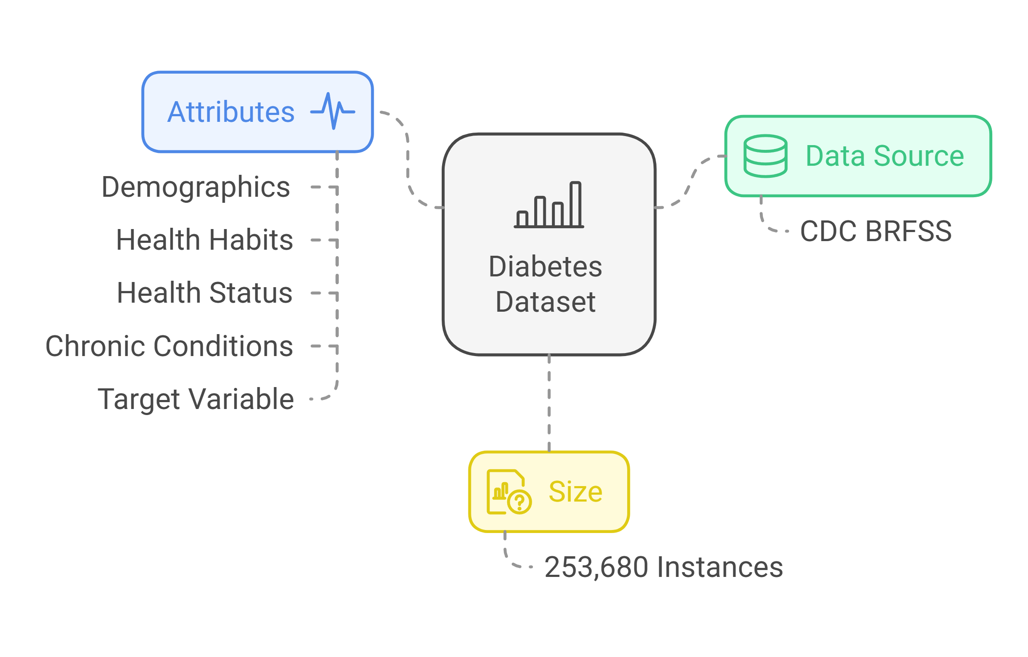
Description of The Dataset

Slide 4
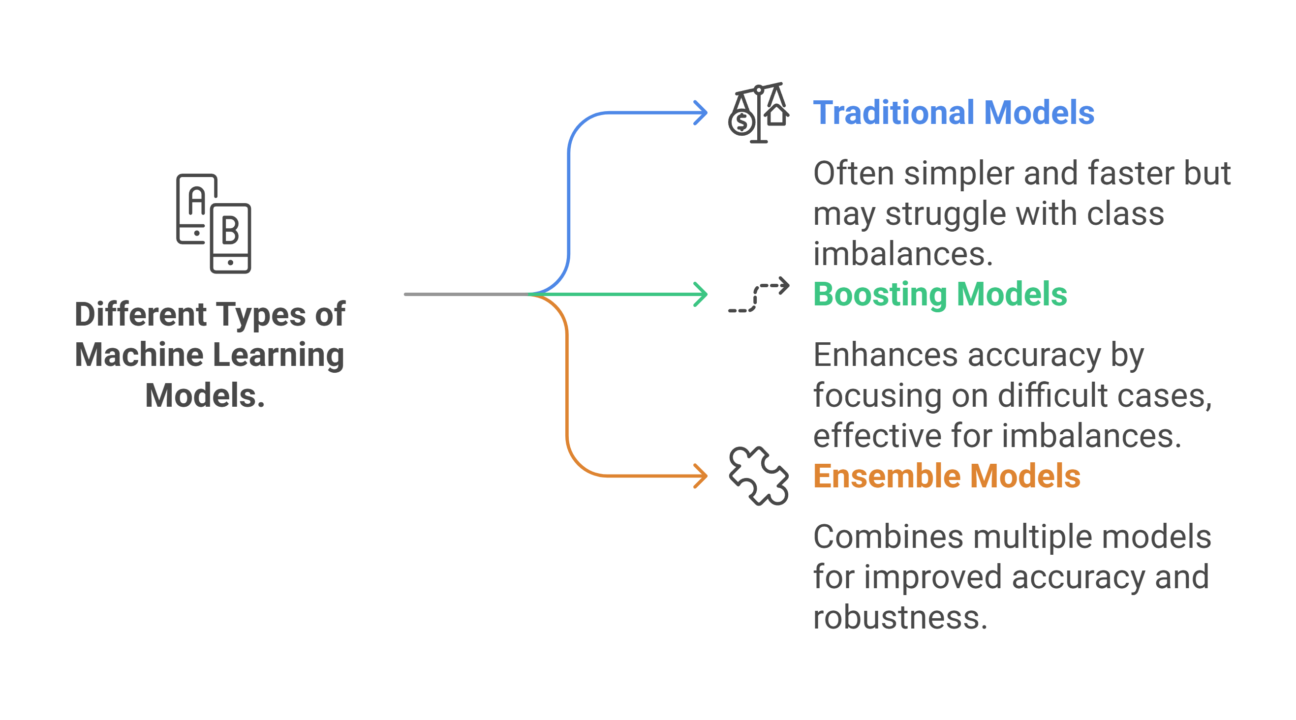

Slide 5
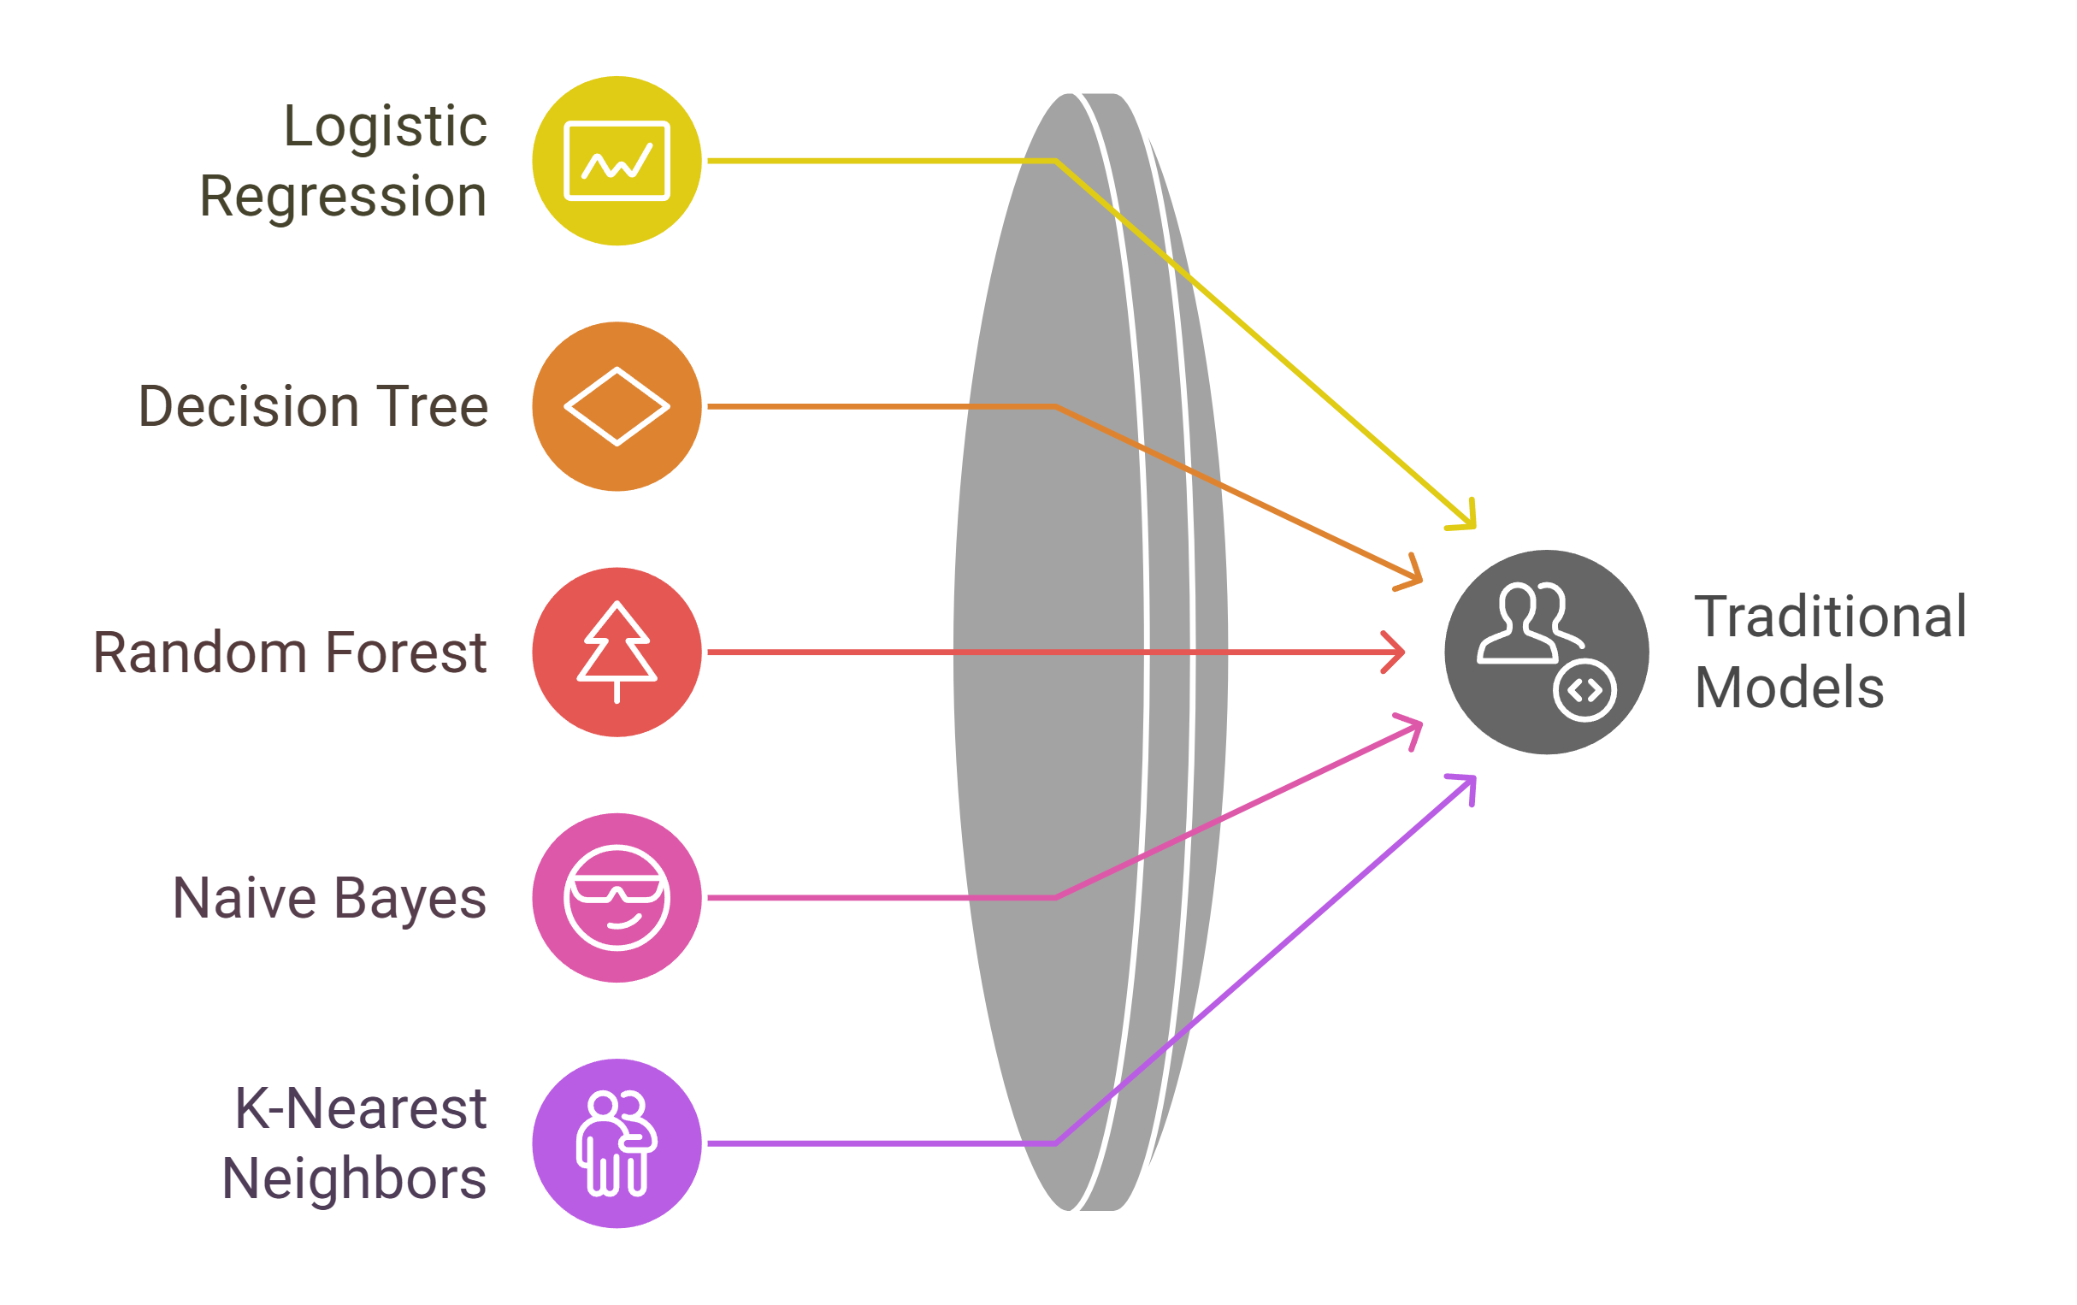

Slide 6
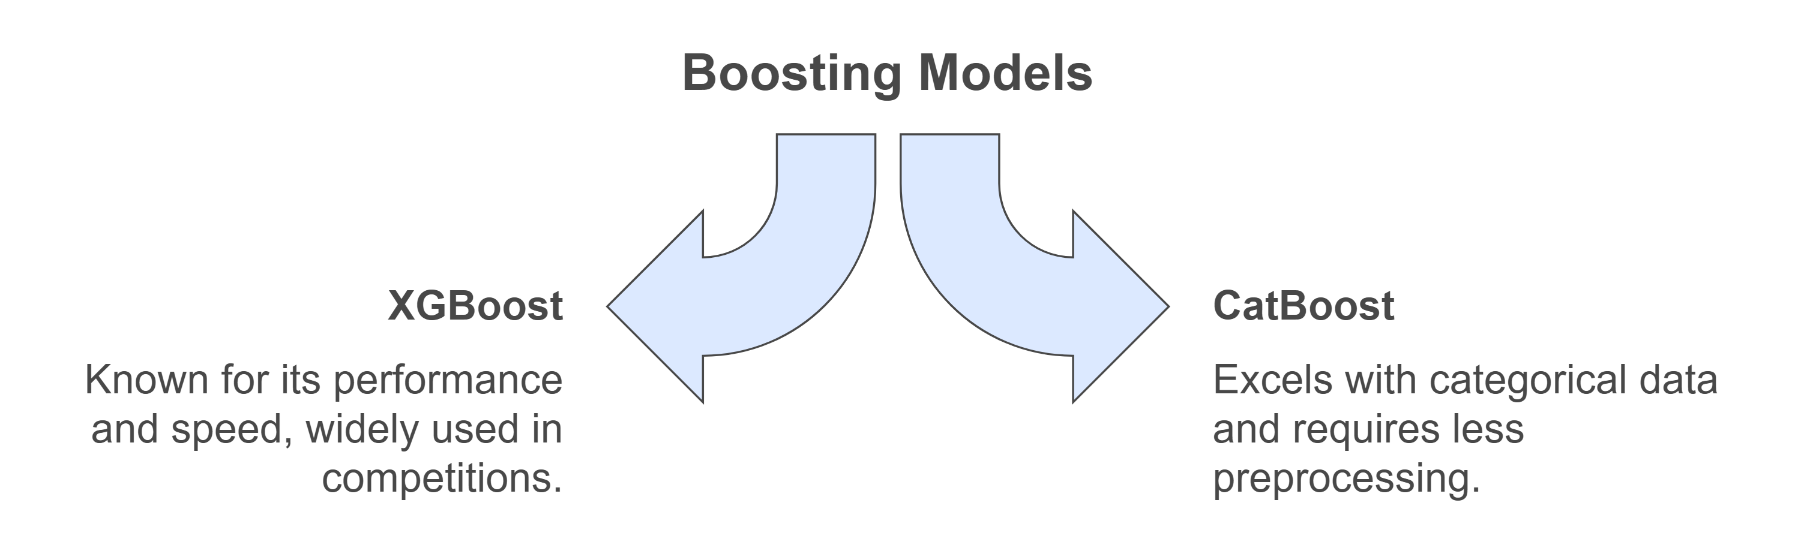

Slide 7
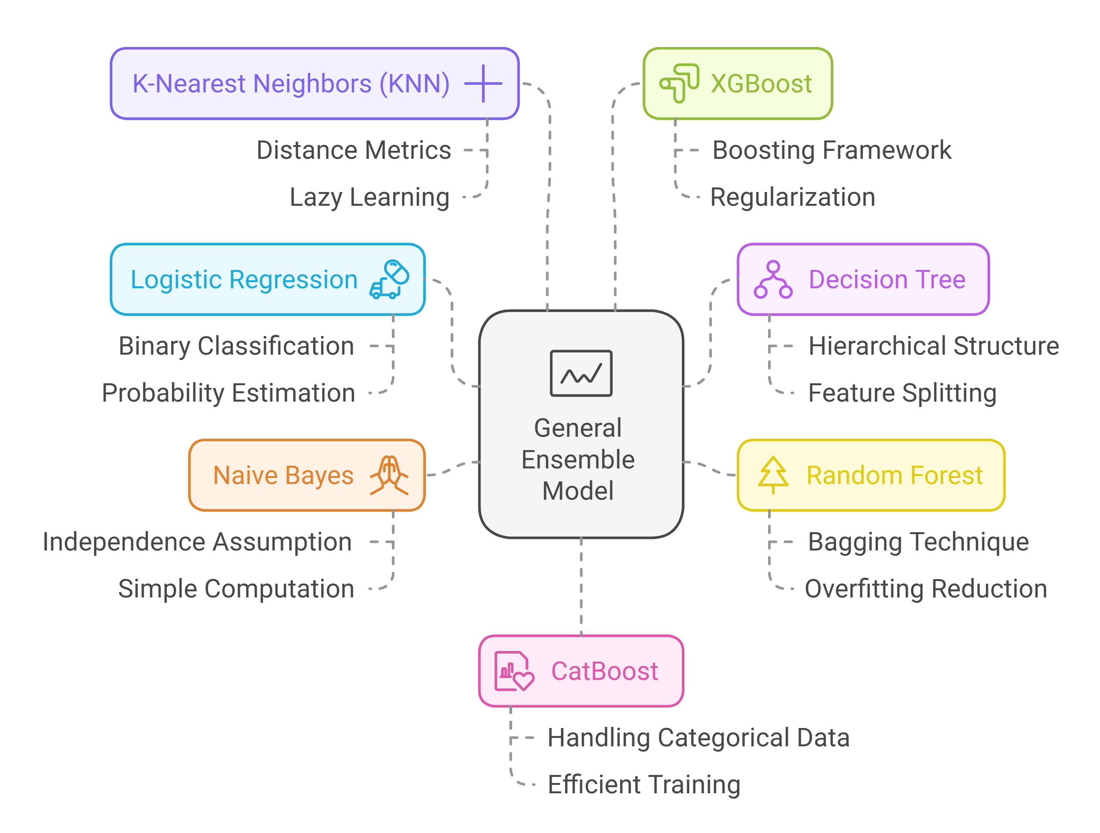

Slide 8
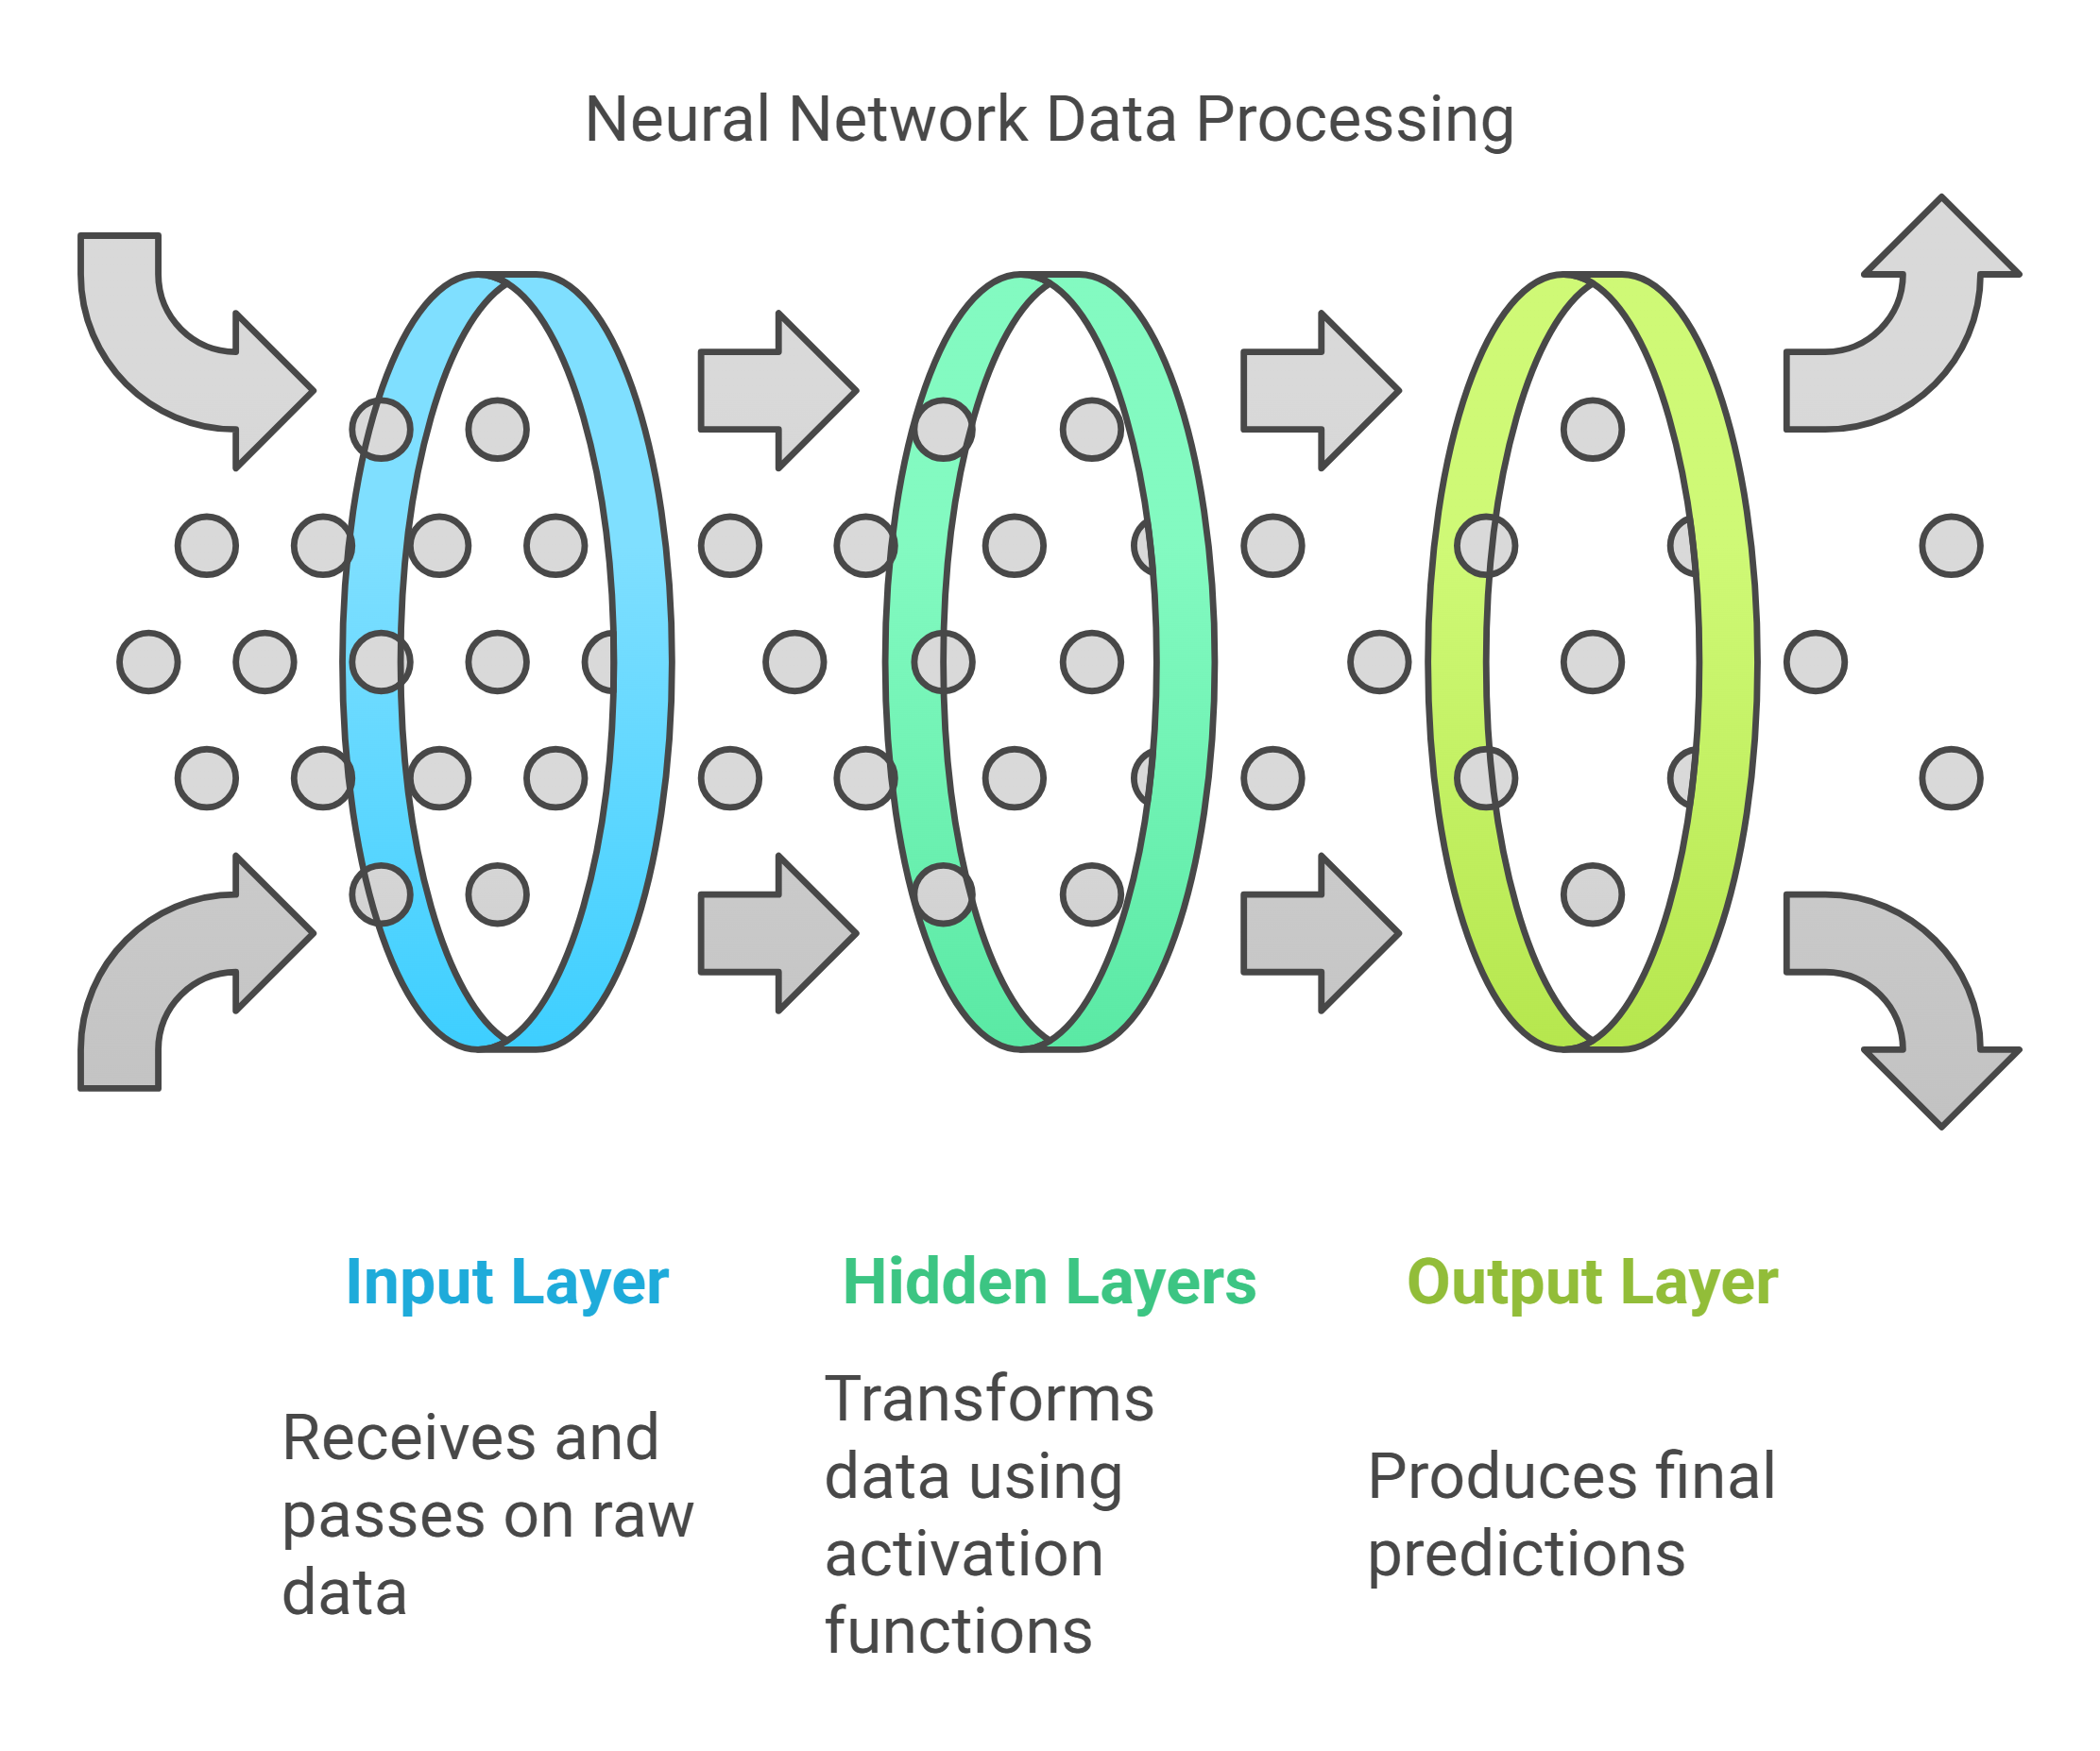

Slide 9
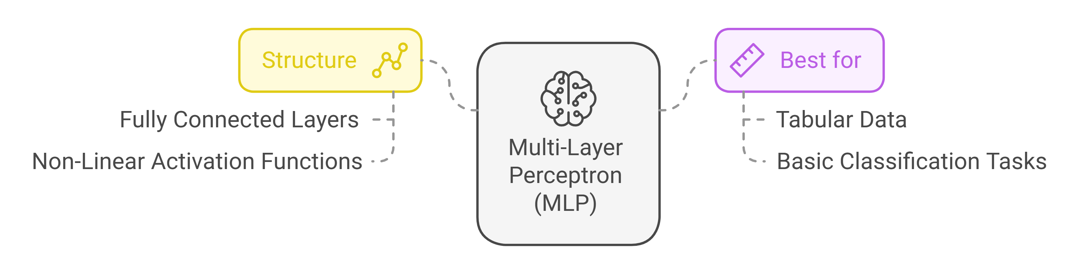

Slide 10
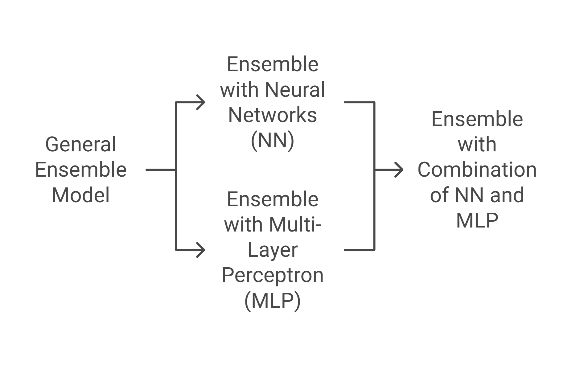
Meta Model Structure

Slide 11
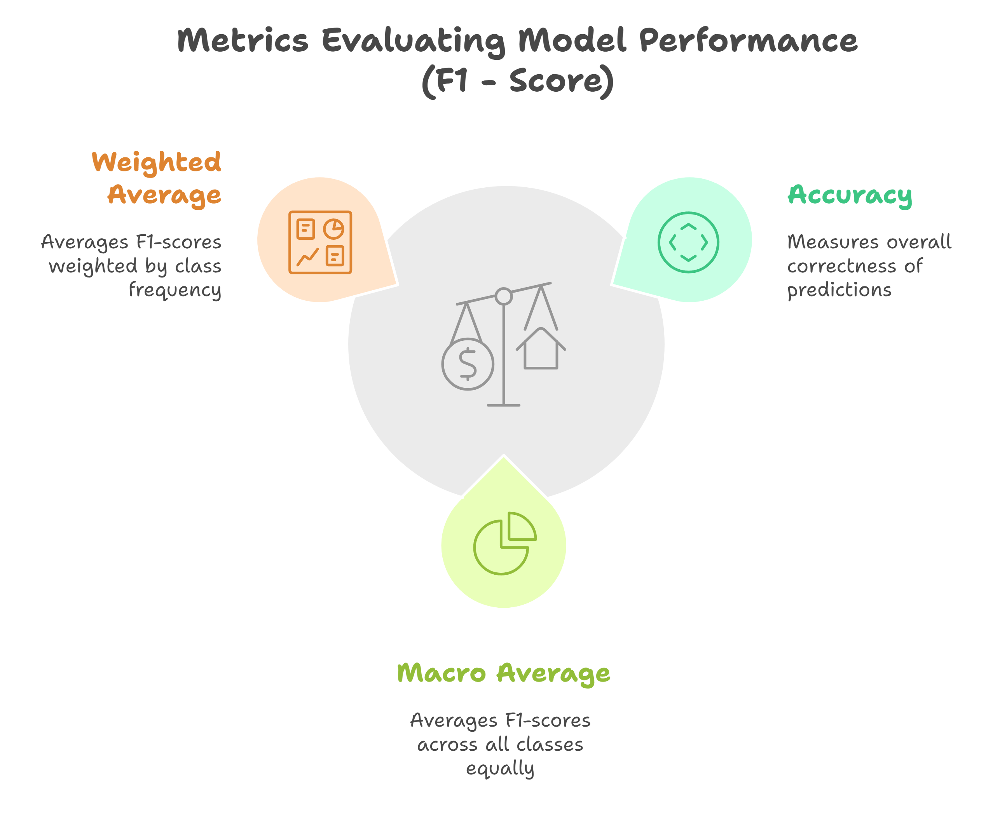

Slide 12
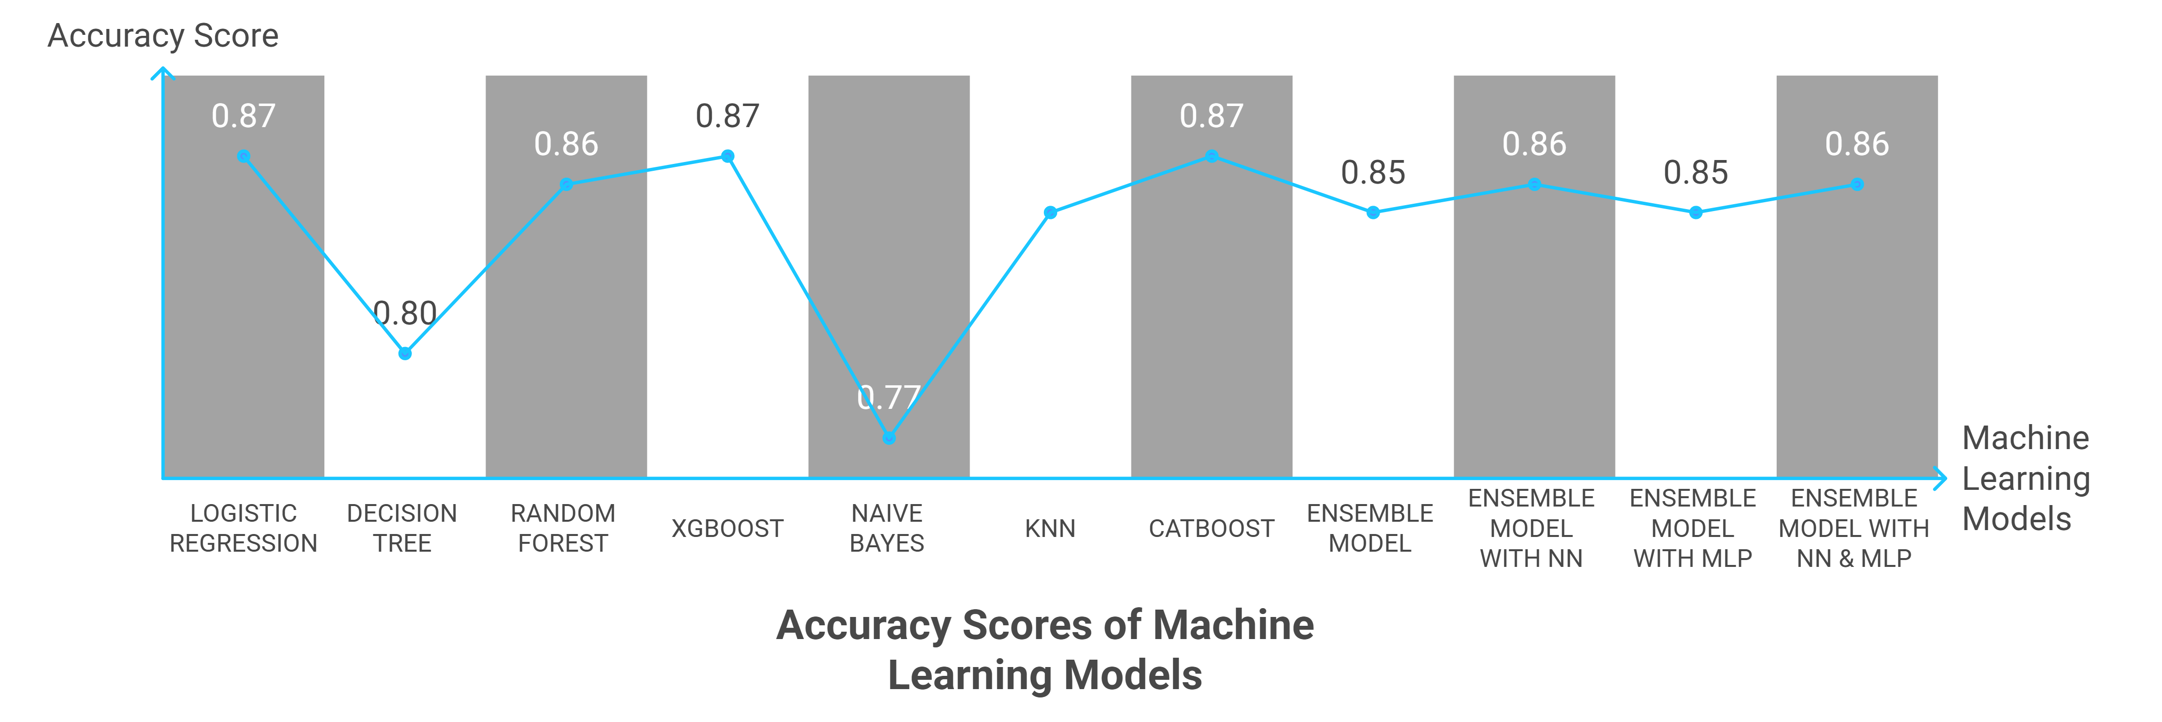

Slide 13
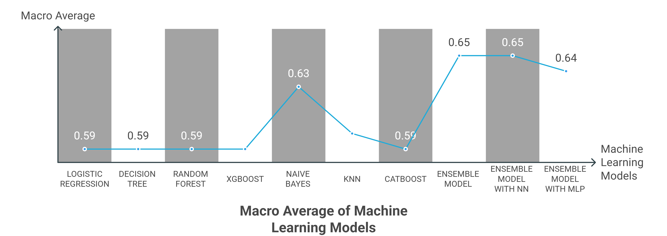

Slide 14
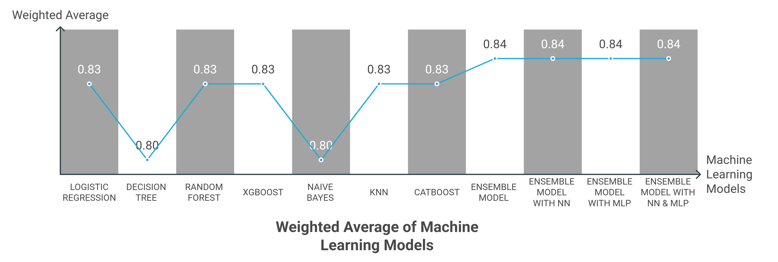

Slide 15

Conclusion
From the graphs of F1-Scores we can see that, Ensemble Model with Nerual Network works better than other models. It has slight lower accuracy, but it has better macro average and weighted average value. In conclusion it can be said that for predicting diabetes from our selected dataset Ensemble Model with Neural Network will work better.

